Slide 1
Pressure & Buoyancy

Slide 2
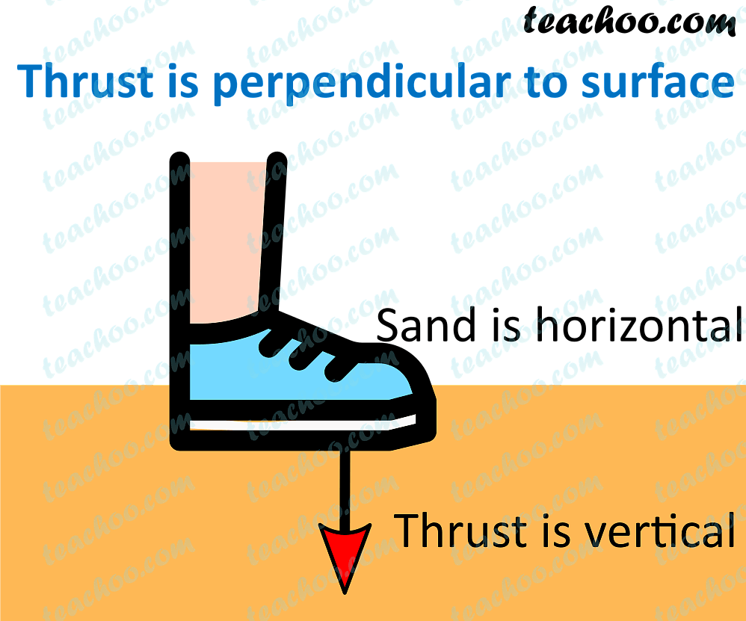
Thrust and Pressure
Thrust: Force acting normally (perpendicular) to a surface.
Pressure:
Pressure=Force (Thrust)/Area
Units:
Force: Newton (N)
Pressure: Pascal (Pa) (1 Pascal = 1 N/m²)

Slide 3
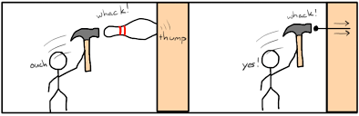
Examples of Pressure
A sharp knife cuts better because it applies more pressure over a small area.
Walking: More pressure while walking than standing because less area is used.

Slide 4
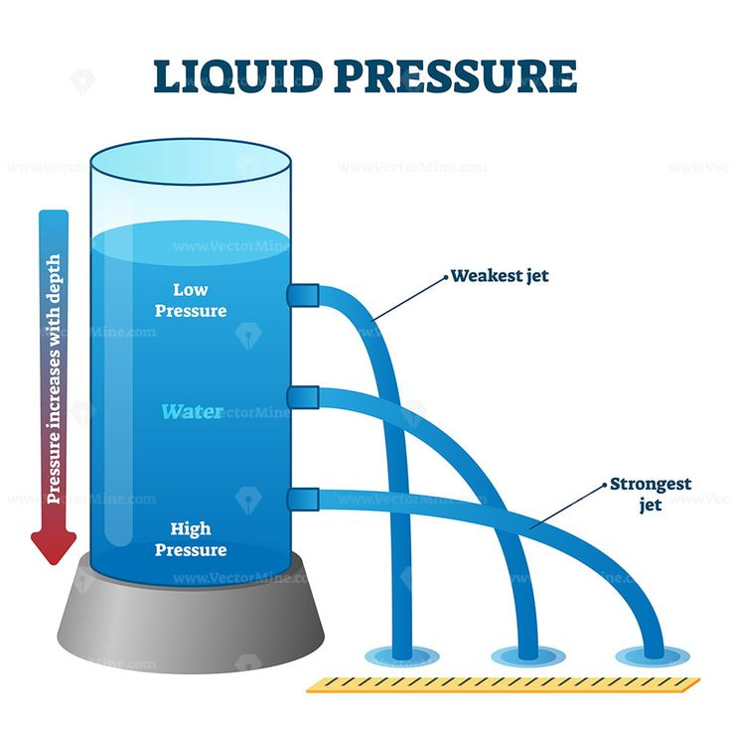
Pressure in Liquids
Liquids and gases can flow → called fluids.
Pressure in fluids:
Acts in all directions.
Increases with depth.

Slide 5
Pressure at depth in a liquid:
P=h×d×g
h = depth (m)
d = density of liquid (kg/m³)
g = gravity (9.8 m/s²)

Slide 6
Atmospheric Pressure
Air also applies pressure = Atmospheric Pressure.
At sea level, atmospheric pressure = pressure due to 0.76 m of mercury column.

Slide 7
Example Problems
Q: Find pressure at 15 cm depth, density = 1.2 g/cm³.

Slide 8
Solution:
P=h×d×g

Slide 9
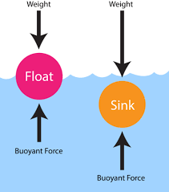
Buoyancy and Upthrust
When an object is in a liquid:
Liquid pushes it up → Upthrust.
Buoyant Force: Upward force exerted by a fluid.

Slide 10
Factors Affecting Upthrust
More Volume submerged → More upthrust.
Denser liquid → More upthrust.

Slide 11
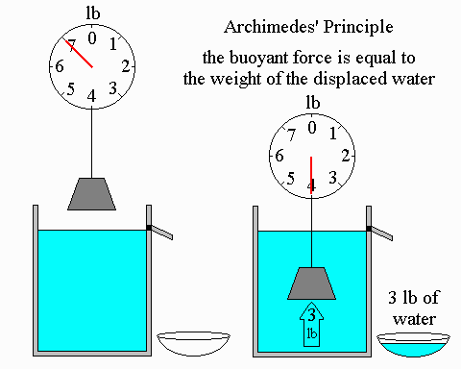
Archimedes’ Principle
A body immersed in a liquid experiences:
Upthrust = Weight of liquid displaced.
Formula:
F=V×d×g
where V = Volume submerged.

Slide 12
Example
Object weight in air = 300 gmF
Weight in water = 260 gmF
Loss in weight = 40 gmF
Upthrust = 40 gmF

Slide 13
Density
Density =
Density=Mass/Volume
SI: kg/m³ CGS: g/cm³
Water density = 1 g/cm³

Slide 14
Density and Temperature
Heating → Decreases density (expansion).
Water is special!
Max density at 4°C.

Slide 15
Question
Weight in air = 60 gmF
Weight in water = 52 gmF
What is buoyant force?

Slide 16
Solution
Loss = 8 gmF
Volume = 8 cm³

Slide 17
Key Takeaways
Pressure = Force / Area.
Pressure increases with depth.
Buoyancy = Upthrust by liquid.
Archimedes Principle = Upthrust = Weight of liquid displaced.
Density = Mass / Volume.

Slide 18
The pressure applied on a body depends on: A) Force B) Area C) Both force and mass D) Both force and area

Slide 19
Answer: D) Both force and area

Slide 20
The formula for pressure is: A) Force × Area B) Force / Area C) Area / Force D) None of these

Slide 21
Answer: B) Force / Area

Slide 22
Which of the following is NOT a unit of pressure? A) Bar B) Newton C) Pascal D) atm

Slide 23
Answer: B) Newton

Slide 24
How does pressure vary as we move from sea level to mountain top? A) Decreases B) Increases C) Increases up to a few kilometers and then decreases D) Decreases up to a few kilometers and then increases

Slide 25
Answer: A) Decreases

Slide 26
HOTS
A diver is 20 meters below the surface of the sea. The density of seawater is 1030 kg/m³ Find the pressure exerted by the water at that depth. (Take g=9.8 m/s²

Slide 27
P=h×d×g

Slide 28
A metal block weighs 100 N in air. When fully submerged in water, it weighs 80 N. Find: (a) The buoyant force acting on the block. (b) The volume of the block. (Take density of water =1000 kg/m³, g=10 m/s²)

Slide 29
Buoyant force = Loss in weight
=100−80=20 N
Buoyant force= V x d x g

